Slide 1
Low-rank approximation of Hyperspectral Image dataset
September 7, 2018

Slide 2
Outline
Problem statement
Denoising
Low rank decomposition of the dataset
Discussions

Slide 3
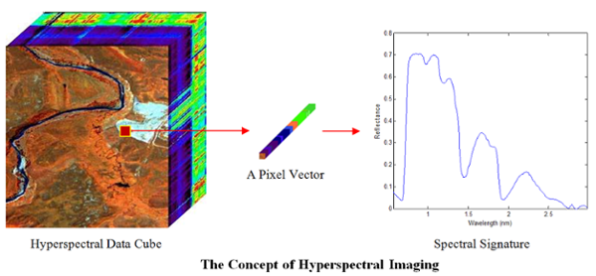
Hyperspectral Image
Image source:https://udayton.edu/engineering/centers/vision_lab/was_data_analysis_and_processing/hyperspectral_data_processing.php

Slide 4
Problem Statement
Finding the low-rank approximation of the Hyperspectral datasets using CP and Tucker decompositions.
Evaluate the performance using different metrics like SNR,ERGAS etc.
Also evaluate the Classification accuracy.

Slide 5


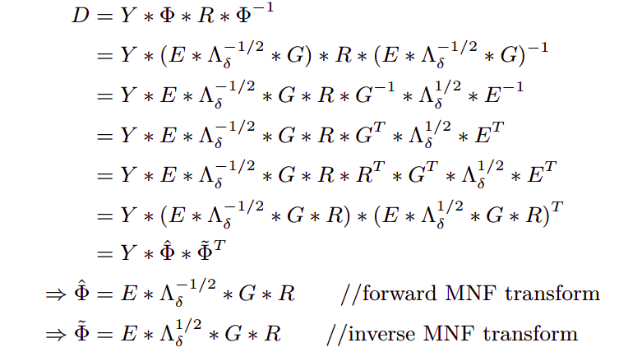




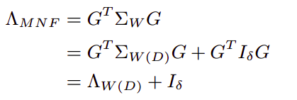
Denoising (Fast MNF)

Slide 6
Denoising
Fast MNF described in [1] was used to denoise the Hyperspectral dataset.
Noise co-variance Matrix is estimated as described in [2] paper. The idea is to use neighbouring pixels of same material instead of the right pixel.
[1]A Fully Automated, Faster Noise Rejection Approach Increasing the Analytical Capability of Chemical Imaging for Digital Histopathology
[2]Efficient Clustering-based Noise Covariance Estimation for Maximum Noise Fraction

Slide 7
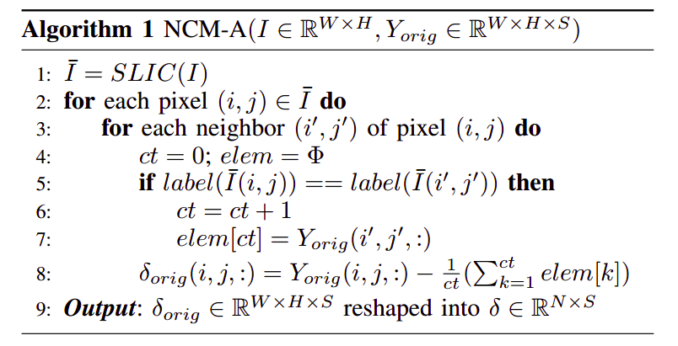
Denoising
Simple Linear Iterative Clustering (SLIC) superpixel of Achanta et al
All inverse operations and replace them with transpose, thereby making computations faster. Owing to the symmetric structure of covariance matrices, we also compute the singular value decomposition using eigen decomposition which is faster. Also, the transformation matrices are of size (S × K) instead of (S × S) where K <<S.

Slide 8



Classification improved after Denoising
Noisy Image(60.95%)
Denoised Image(75.94%)
Groundtruth

Slide 9
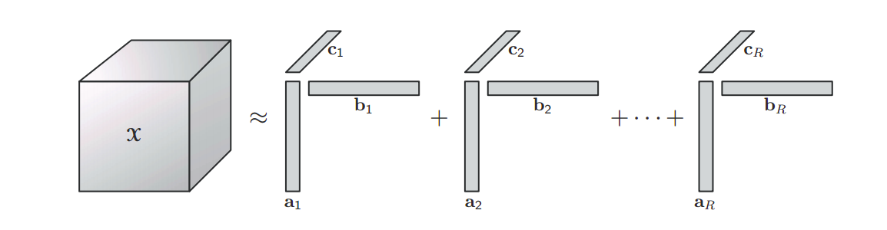

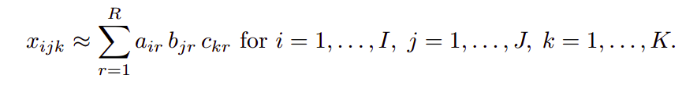
Low-rank decomposition
CP decomposition

Slide 10
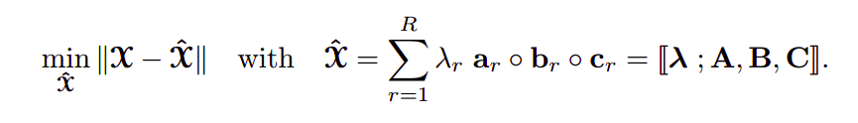
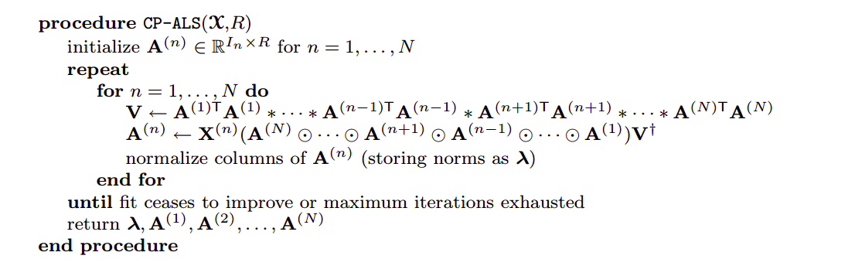
Low-rank decomposition
CP decomposition

Slide 11
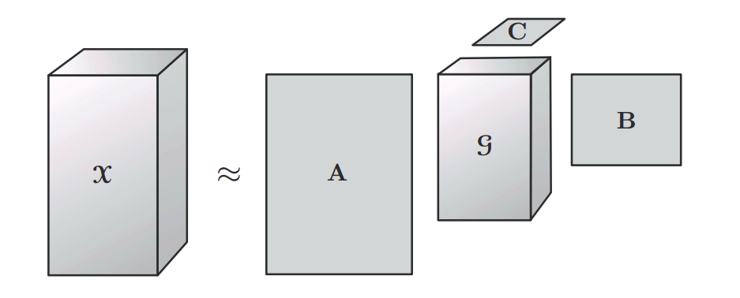
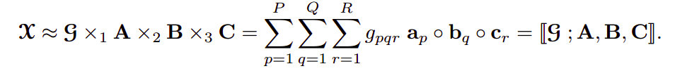
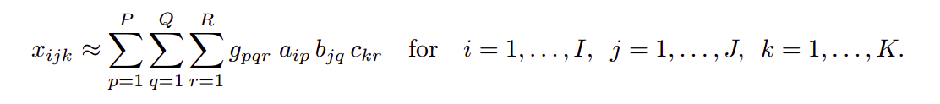
Low-rank decomposition
Tucker decomposition

Slide 12
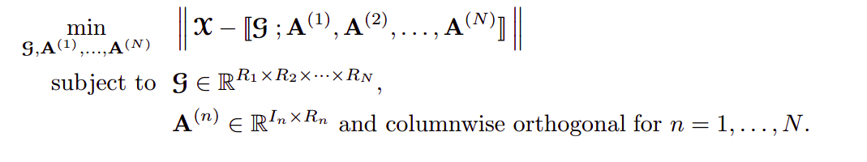
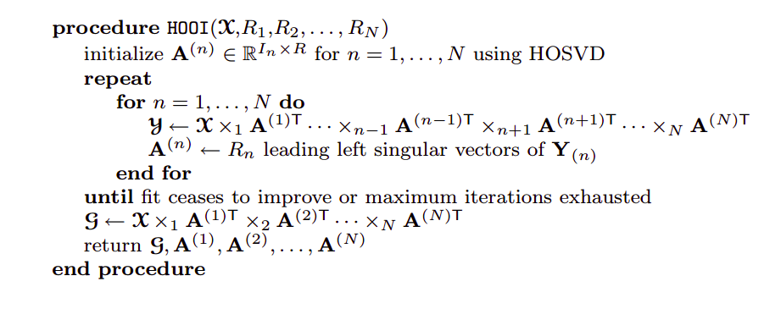
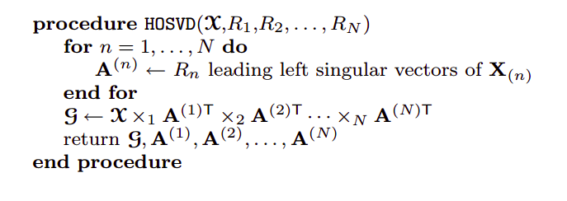
Low-rank decomposition
Tucker decomposition

Slide 13
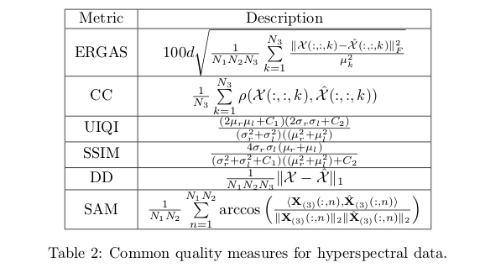
Metrics used

Slide 14
3. Experiments

Slide 15

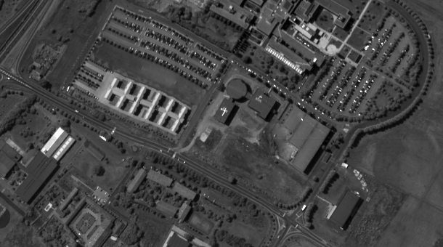
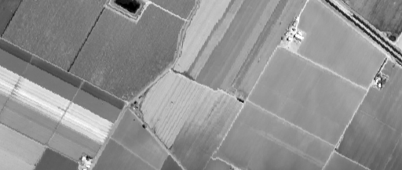
Test Datasets
Indian Pines (145*145*224) [ 16 classes]
Pavia University(610*340*103) [9 classes]
Salinas (512*217*204) [ 16 classes]

Slide 16
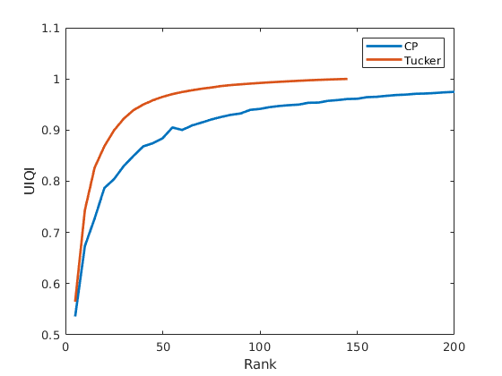
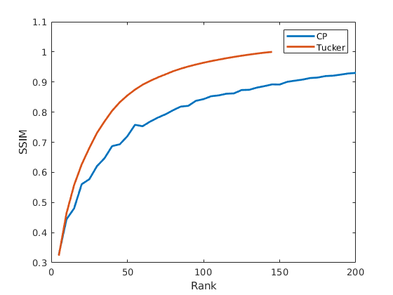
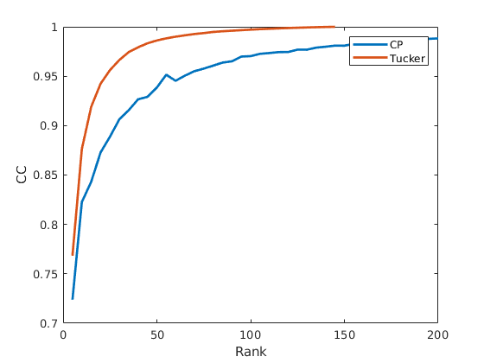
Indian Pines ( Larger the better)

Slide 17
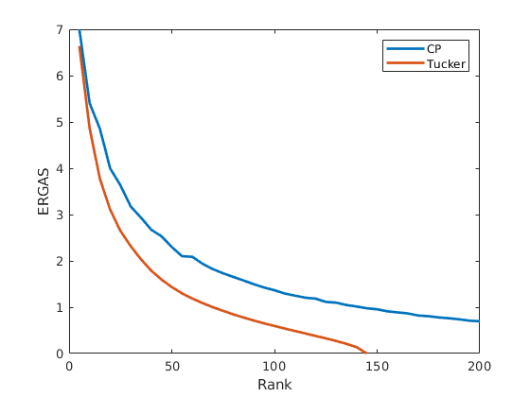
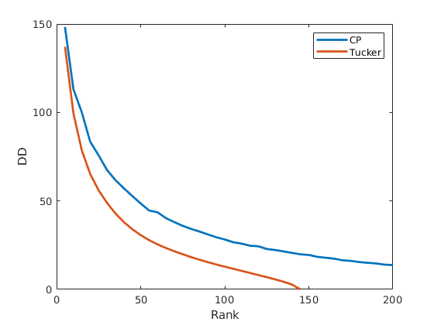
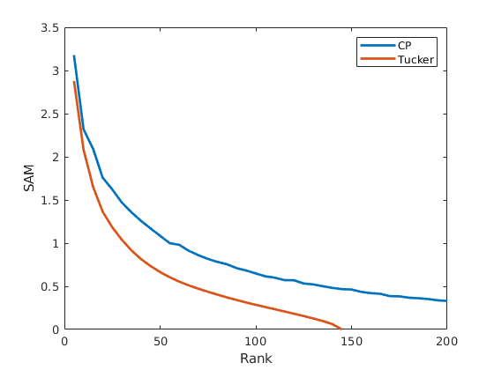
Indian Pines ( smaller the better)

Slide 18
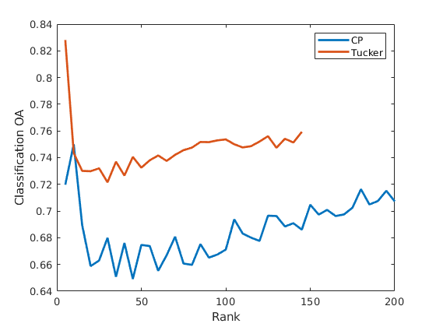
Indian Pines-Classification

Slide 19
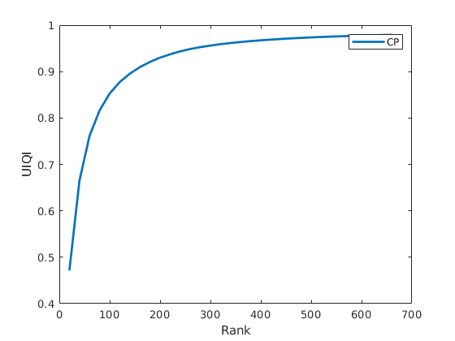
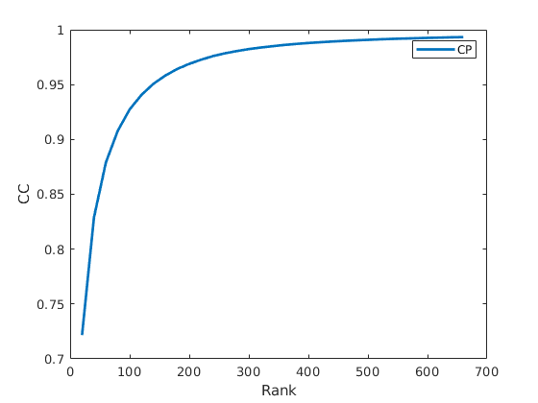
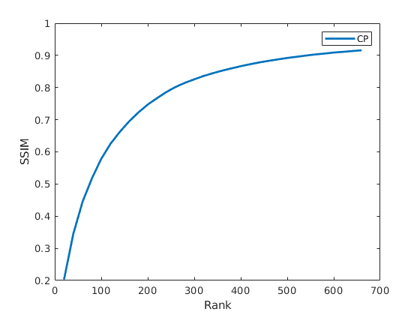
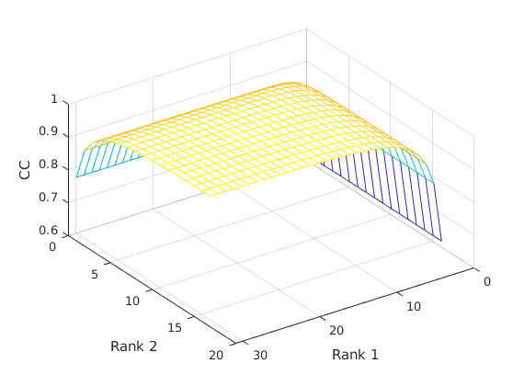
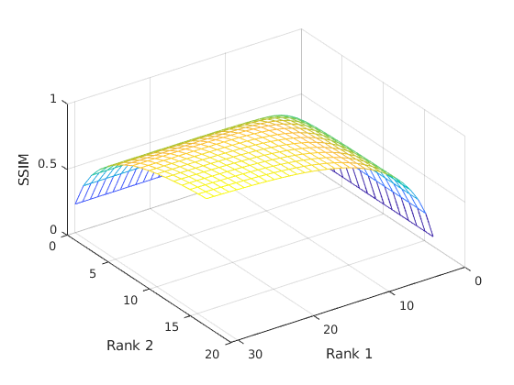
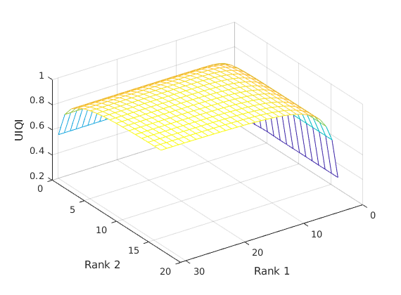
Pavia University ( Larger the better)

Slide 20
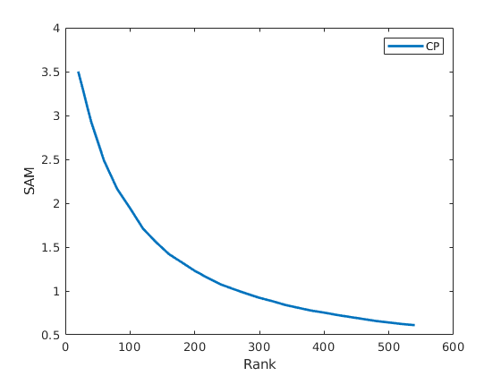
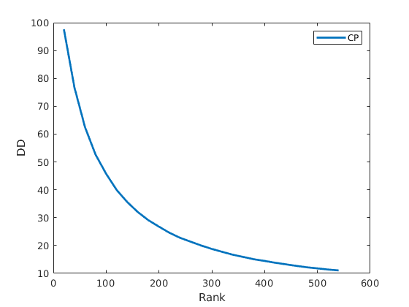
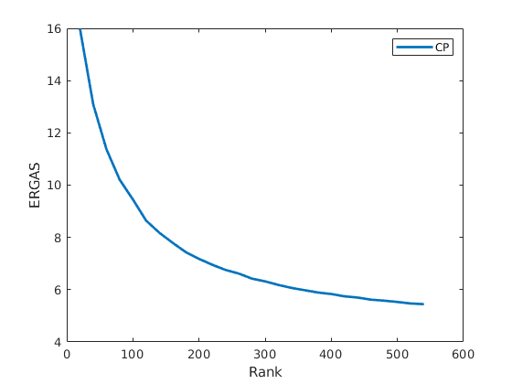
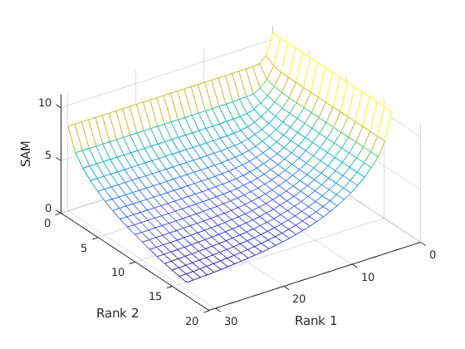
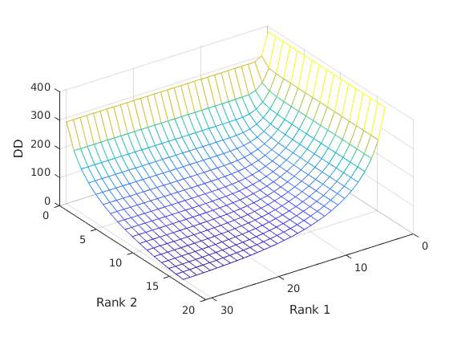
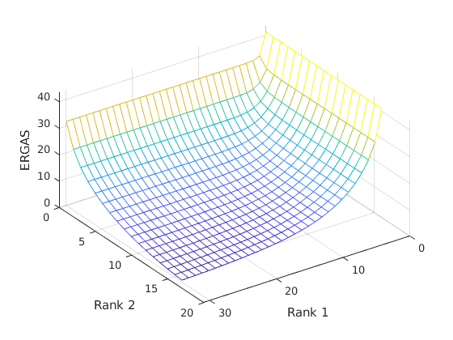
Pavia University ( smaller the better)

Slide 21
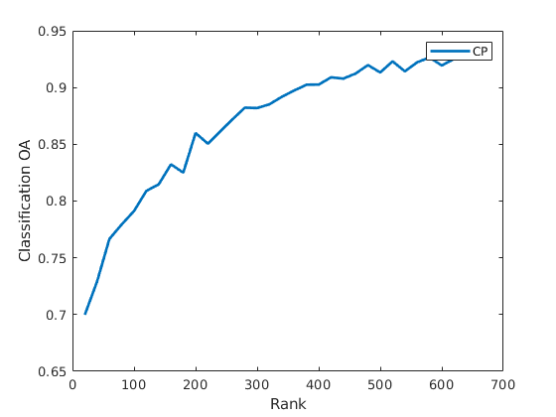
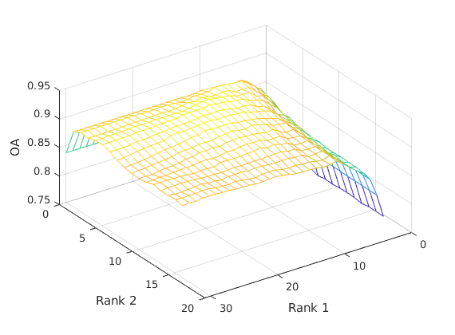
Pavia University-Classification

Slide 22
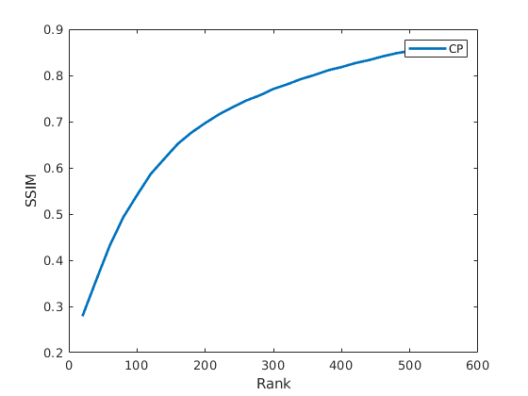
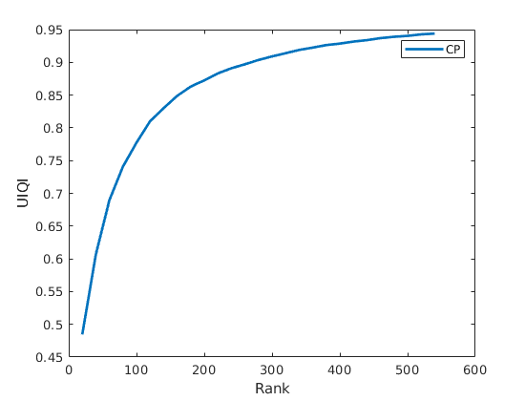
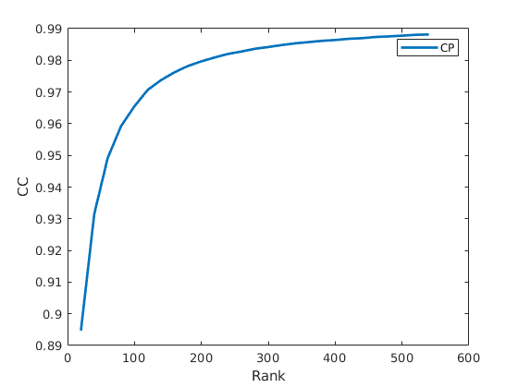
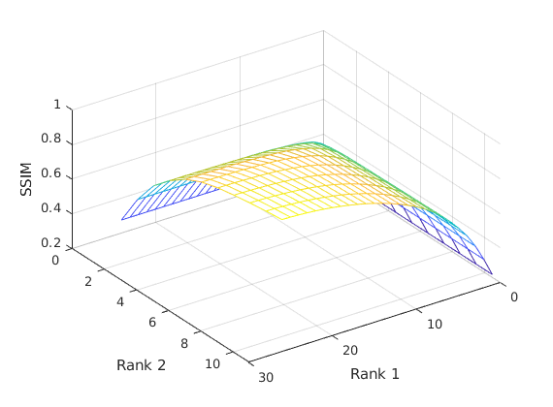
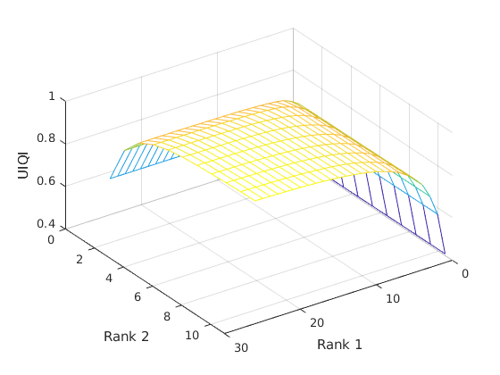
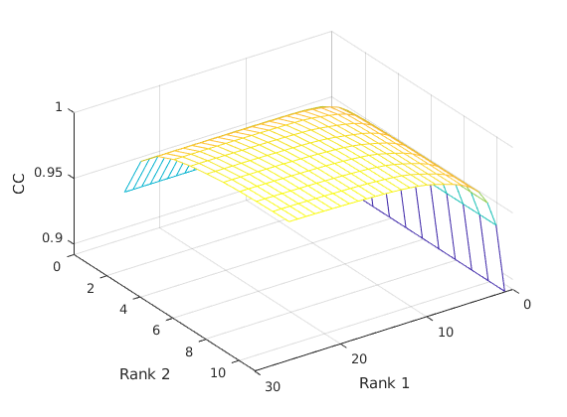
Salinas ( Larger the better)

Slide 23
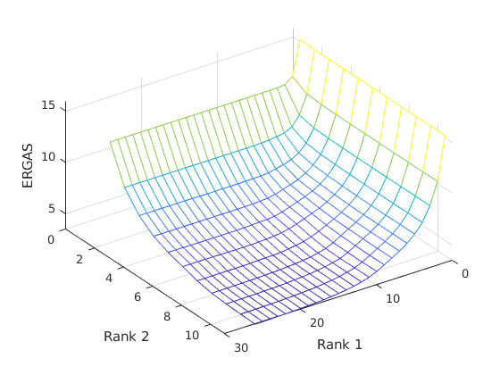
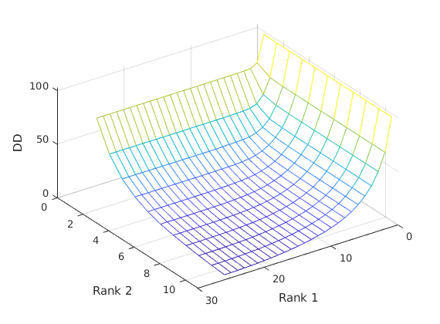
Salinas ( smaller the better)

Slide 24
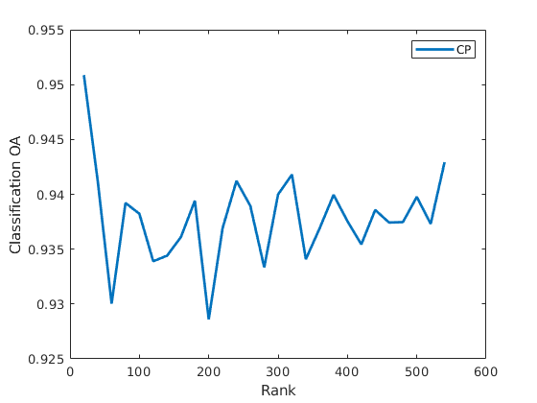
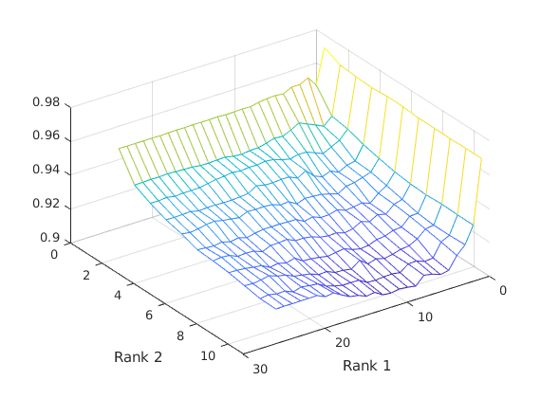
Salinas-Classification

Slide 25
Conclusion
Higher rank gave better results in most of the metrics other than classification.
Low rank can give better results in terms of Classification in Spatially simple cases .

